Slide 1
Articles
A, An ,The

Slide 2
Definition
Articles are referred to as definite or indefinite.
When we introduce someone or something ,we generally precede the noun with the article a or an.(Indefinite)
When the object has been introduced ,we use the article “the” for further referring to it.(Definite)

Slide 3
Some Important points
So it must be clear that articles are used before nouns.
Articles are also referred to as adjectives because they talk of something about the noun.
We use a/an before a singular noun when it is not specific or indefinite
We use “The” before a singular noun when we refer to some specific or definite thing
“The” is the most widely used word in the English language

Slide 4
Lets understand this with the help of an example
A son took his old father to a restaurant for an evening dinner. Father being very old and weak, while eating, dropped food on his shirt and trousers. Others diners watched him in disgust while his son was calm.
After he finished eating, his son who was not at all embarrassed, quietly took him to the wash room, wiped the food particles, removed the stains, combed his hair and fitted his spectacles firmly. When they came out, the entire restaurant was watching them in dead silence, not able to grasp how someone could embarrass themselves publicly like that.
The son settled the bill and started walking out with his father.
At that time, an old man amongst the diners called out to the son and asked him, “Don’t you think you have left something behind?”.
The son replied, “No sir, I haven’t”.
The old man retorted, “Yes, you have! You left a lesson for every son and hope for every father“.

Slide 5
Usage of the article “A”
As already mentioned we use “a” when we introduce something.
Use a with names of jobs.
Example
John is a doctor.
Use a with nationalities and religions in the singular.
Example
Kate is a Catholic.
Use a with the names of days of the week when not referring to any particular day.
Examples
1.I was born on a Thursday.
2.Could I come over on a Saturday sometime?

Slide 6
Some other uses of article “A”
Use a to refer to an example of something.
Examples
1.The mouse had a tiny nose .
2.The elephant had a long trunk .
3.It was a very strange car .
Use a with singular nouns after the words 'what' and 'such'.
Examples
1.What a shame!
2.She's such a beautiful girl.
3.What a lovely day!
Use a meaning 'one', referring to a single object or person, or a single unit of measure.
Example
1.I can think of a hundred reasons not to come.

Slide 7
Differentiating between a/an
While differentiating between the use of “A” and “An”, remember that “An” is used before a vowel sound.
Remember that there are 5 vowels but we have 20 vowel sounds.
For example:
1.There is a university in my hometown.
Although university starts with a vowel “u”but it is not a vowel sound.
2.Brutus is an honourable man.
Although the word honourable starts with a consonant “h” but the sound is that of a vowel. So we will precede it with “an”.
3.He lives in a European country.
The word “European” starts with E which is a vowel but the sound is a “u” sound. Therefore it will not be preceded by the article “an”

Slide 8
Usage of the Zero article
Generally we do not use any article before a proper noun.
For example,we do not say The Akshay or The LPU
We don’t use any article before a material or an abstract noun
1.Iron forms the crust of Earth as well as Mars.
2.Happiness is the ultimate goal of life
No article is used when making generalization with plural countable nouns or Singular uncountable nouns.
Example:
Books are man’s best friends.

Slide 9
Usage of the article “The”
“The” is used for referring to a specific object.
Example:Give me the pencil that I gave you yesterday.
Generally we do not use any article before a proper noun ,for example we do not say The Sachin tendulkar or The India but there are a few exceptions to this rule:
We use “The” before the names of rivers,seas,oceans,mountain ranges,group of islands ,canals,deserts.
Example: The Himalayas,The Indian Ocean,The Arabian Sea
2.Before certain countries or organisations which include words like republic,state and kingdom.
Example: The USA,The UK,The United nations
3.Before names of religious books(The Gita,The Mahabharata)

Slide 10
Some other usages of article “The”
When there is only one such person,place or thing.
Example:
The prime minister of India,The Statue of Unity.
Before names of famous buildings.
The Red Fort,The parliament house
Before a singular noun that refers to a whole class.
Example:
The Downtrodden,The Japanese
Before abbreviations like The BBC,The USSR

Slide 11

Some common errors in the Usage of A,An and The

Slide 12
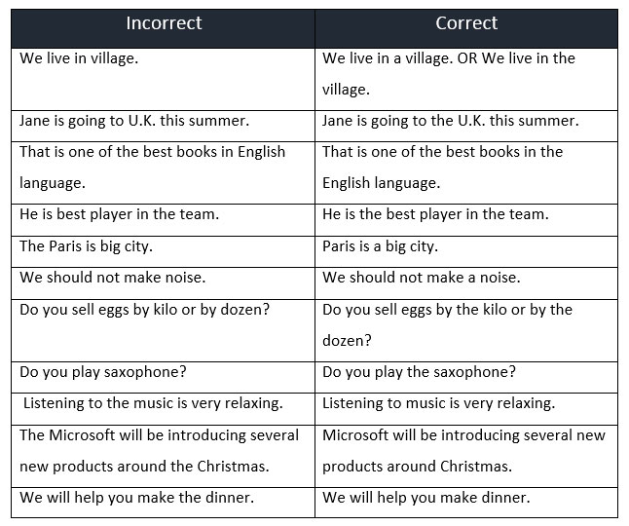

Slide 13
Do not use A,an before Uncountable nouns
For example:
I will give you an information (Incorrect)
I will give you information.(correct)
I will give you an advice.(Incorrect)
I will give you a piece of advice.(Correct)

Slide 14
Do NOT use THE with individual lakes or mountains:
Mount Everest is the highest mountain the world.
We went sailing on Lake Ontario.
There are certain exceptions in the use of articles:
We can say
Virat Kohli is the Sachin tendulkar of today.
A Mukesh has come to see you.

Slide 15

Some example paragraphs

Slide 16
BENGALURU: ______ few days into ______ nationwide lockdown, ______ villagers of Agumbe Panchayat in Theerthahalli Taluk of Karnataka’s Shimoga district, found themselves in a fix. While in their part of the world, _____ patchy mobile network is part of every day, _____ lockdown had brought its own set of complications. Rations shops were refusing to hand out essentials to the villagers unless provided with _____ one-time password or ____ OTP. According to the rules, ____ration card holder receives an OTP, which he/she has to show to avail ____ ration. Unfortunately, for the villagers, no network meant no OTP — and that meant no ration.

Slide 17
BENGALURU: A few days into the nationwide lockdown, the villagers of Agumbe Panchayat in Theerthahalli Taluk of Karnataka’s Shimoga district, found themselves in a fix. While in their part of the world, a patchy mobile network is part of every day, the lockdown had brought its own set of complications. Rations shops were refusing to hand out essentials to the villagers unless provided with a one-time password or an OTP. According to the rules, a ration card holder receives an OTP, which he/she has to show to avail the ration. Unfortunately, for the villagers, no network meant no OTP — and that meant no ration.

Slide 18
Ever since ______ country imposed _____ lockdown to break ______ transmission of coronavirus, government agencies have been trying hard to sensitise people about ______ importance of social distancing and staying at home. Tiruppur Collector Dr K Vijayakarthikeyan seems to be ahead of the curve in sending across this message to the people of his district. Using social media and implementing innovative ideas on the ground, he has been creating awareness about _____ pandemic in the most effective way. _____disinfection tunnel, ______ WhatsApp group to bust fake news and social media challenges are some of ______ initiatives Vijayakarthikeyan has undertaken to fight Covid-19 in Tiruppur.

Slide 19
Ever since the country imposed a lockdown to break the transmission of coronavirus, government agencies have been trying hard to sensitise people about the importance of social distancing and staying at home. Tiruppur Collector Dr K Vijayakarthikeyan seems to be ahead of the curve in sending across this message to the people of his district. Using social media and implementing innovative ideas on the ground, he has been creating awareness about the pandemic in the most effective way. A disinfection tunnel, a WhatsApp group to bust fake news and social media challenges are some of the initiatives Vijayakarthikeyan has undertaken to fight Covid-19 in Tiruppur.

Slide 20
Thank You

